Slide 1
Java EE Training Course
Java Message Service
Notes:
ATS Application Programming: Java Programming
Brown Bag: XML
© Accenture 2005 All Rights Reserved
Course Code #Z16325

Slide 2
Agenda
Messaging architecture
Java Message Service overview
JMS objects
Sending JMS messages
Receiving JMS messages
Activity
Notes:
ATS Application Programming: Java Programming
Brown Bag: XML
© Accenture 2005 All Rights Reserved
Course Code #Z16325

Slide 3
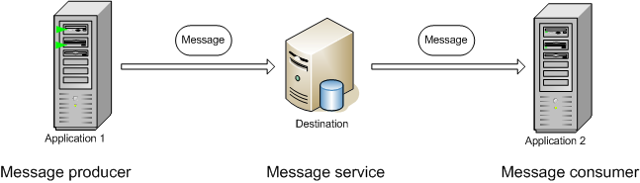
Messaging architecture
Messaging - a method of communication between applications.
A messaging client can send/ receive messages to/from any other client.
Each client connects to a messaging agent that provides facilities for creating,
sending, receiving, and reading messages.
Messaging enables distributed communication that is loosely coupled:
The sender and the receiver do not have to be available at the same time in order to communicate.
The sender and the receiver need to know only which message format and which destination to use.
JMS Provider

Slide 4
Java Message Service
Java Message Service API (JMS API) allows applications to create, send, receive, and read messages.
The JMS API enables communication that is:
Asynchronous: a JMS provider can deliver messages to a client as they arrive; a client does not have to request messages in order to receive them.
Reliable: The JMS API can ensure that a message is delivered once and only once. Lower levels of reliability are available for applications that can afford to miss messages or to receive duplicate messages.
JMS supports two messaging models:
point-to-point (PTP) - delivery of a message to exactly one recipient
publish/subscribe (pub/sub) - the delivery of a message to multiple recipients
JMS provider – software that implements messaging functionality based on JMS API. Can be separate application or embedded in the Application server.

Slide 5
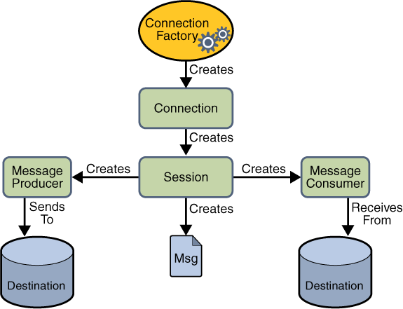
JMS API
javax.jms package
JMS application consist of
Administered objects:
Connection Factories
Destinations
+
Connections
Sessions
Message Producers
Message Consumers
Messages

Slide 6
JMS API – Administered Objects
Connection Factory - the object a client uses to create a connection to a provider.
Destination - is the object a client uses to specify the target of messages it produces and the source of messages it consumes:
Queue – destination in the PTP messaging domain
Topic – destination in the pub/sub messaging domain
Administered objects are:
commonly managed by Application server
parametrized on Application server (JMS provider, url, names, etc.)
can be retrieved from Application Server through JNDI:
<jee:jndi-lookup id="connectionFactory" jndi-name="jms/connectionFactory"/>
<jee:jndi-lookup id="esbToMcpRequestQueue" jndi-name="jms/queue/mainQueue"/>

Slide 7
JMS API – Connect to JMS provider
Connection - encapsulates a virtual connection with a JMS provider.
A connection could represent an open TCP/IP socket between a client and a provider service daemon.
Connection connection = connectionFactory.createConnection();
connection.start();
…
connection.close(); // close any connections before application completes
// also closes its sessions, message producers/consumers.
Session - a single-threaded context for producing and consuming messages.
Session session = connection.createSession(false, Session.AUTO_ACKNOWLEDGE);
The first argument means that the session is not transacted;
the second means that the session automatically acknowledges messages when they have been received successfully.

Slide 8
JMS API – Sending messages
Message - encapsulates the information exchanged by applications.
A JMS message has three parts:
header, contains system fields - JMSMessageID, JMSDestination, etc.
properties, contains custom properties set by user
body, contains content defined by message type(TextMessage,BytesMessage, …)
Message message = session.createTextMessage("I‘m JMS message");
message.setIntProperty("amount", 10);
Message Producer - an object that is created by a session and used for sending messages to a destination.
MessageProducer producer = session.createProducer(queue);
producer.send(message);

Slide 9
JMS API – Receiving messages
Message Consumer - an object that is created by a session and used for receiving messages from a destination. Consumer can receive messages:
1) synchronously
MessageConsumer consumer = session.createConsumer(inQueue);
connection.start(); // connection should be started to receive messages
Message m = consumer.receive(); // or with timeout
2) asynchronously
MessageConsumer consumer = session.createConsumer(inQueue);
connection.start();
consumer.setMessageListener(new MessageListener() {
public void onMessage(Message message) {
…
}
});

Slide 10
Activity
1. Install Apache ActiveMQ 5.14.1 – open source messaging provider
http://activemq.apache.org/download.html
2. Run Apache ActiveMQ with <AMQ location>/bin\win64\activemq.bat
AMQ web interface url: http://localhost:8161/admin/
Login/Password: admin/admin
3. Create 2 queues: IN_QUEUE, OUT_QUEUE

Slide 11
Activity (2)
4. Integrate ActiveMQ with Tomcat
а) context.xml
  <Resource name="jms/connectionFactory" auth="Container"
  type="org.apache.activemq.ActiveMQConnectionFactory"
  factory="org.apache.activemq.jndi.JNDIReferenceFactory"
  brokerURL="tcp://localhost:61616" brokerName="MyActiveMqBroker"/>
  <Resource name="jms/outQueue" auth="Container"
  type="org.apache.activemq.command.ActiveMQQueue"
  factory="org.apache.activemq.jndi.JNDIReferenceFactory"
  physicalName="OUT_QUEUE"/>
  …
b) Put activemq-client-5.14.1.jar to <Tomcat folder>/lib
5. Implement Flower shop application integration with FlowersGlobal CRM:
а) send xml representation of customer entity to out queue when new customer registers
b) receive new discount request object (customerId, newDiscount) in XML format to change customers discount

Slide 12
Questions:
???
Notes:
ATS Application Programming: Java Programming
Brown Bag: XML
© Accenture 2005 All Rights Reserved
Course Code #Z16325

